Slide 1
Cultural and linguistic competence training

Slide 2
In 1985, the United States Department of Health and Human Services (HHS) released a landmark report, the Secretary’s Task Force Report on Black and Minority Health (Heckler Report). It documented the existence of health disparities among racial and ethnic minorities in the United States.

Slide 3
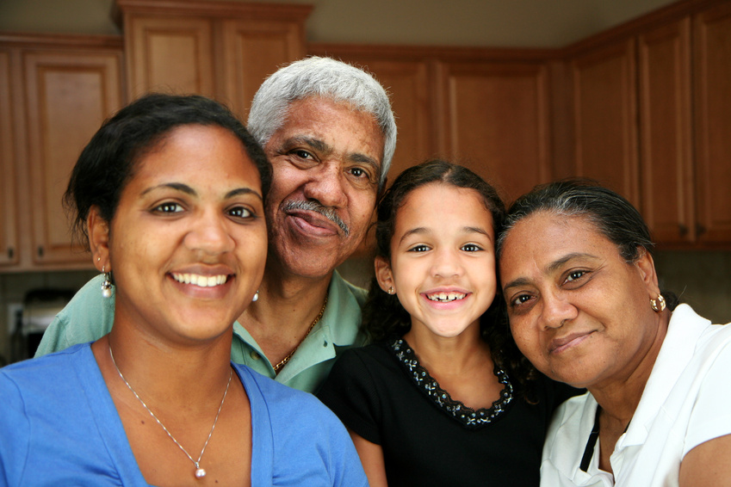
OMH
The Office of Minority Health was created in 1986 as one of the most significant outcomes of the Heckler Report and was reauthorized by the Affordable Care Act (ACA) in 2010.

Slide 4

OMH Mission
The mission of the Office of Minority Health is to improve the health of racial and ethnic minority populations through the development of health policies and programs that will eliminate health disparities.

Slide 5

The Office Of Minority Health Resource center
The Office of Minority Health Resource Center was created in 1987. It is the nation's largest repository of information on health disparity issues. The Office of Minority Health Resource Center is a one-stop shop for minority health literature, research and referrals. It:
provides capacity building and technical assistance to health care agencies and organizations;
conducts health education and awareness campaigns that address disease prevention, health promotion and healthier lifestyle choices

Slide 6

The office of minority health resource center
Call: 1-800-444-6472 (English and Spanish)
TDD: 301-251-1432
Email: info@minorityhealth.hhs.gov
Mail: Office of Minority Health Resource Center
PO Box 37337
Washington, DC 20013-7337
The toll-free telephone line is staffed from 9:00 am to 5:00 pm eastern time, Monday through Friday (closed on federal holidays). The toll-free line is accessible within the continental United States, Alaska, Hawaii, Puerto Rico and the U.S. Virgin Islands.

Slide 7
National CLAS Standards
In 2000, the Office of Minority Health published the first National Standards for Culturally and Linguistically Appropriate Services in Health Care (National CLAS Standards), which provide a framework for all health care organizations to best serve the nation’s increasingly diverse communities.

Slide 8

What are CLAS?
Services that are respectful of and responsive to individual cultural health beliefs and practices, preferred languages, health literacy levels, and communication needs and are employed by all members of an organizations (regardless of size) at every point of contact

Slide 9

enhancement
CLAS standards underwent an enhancement initiative that lasted from 2010 to 2013. This initiative had three major components: a public comment period, a systematic literature review, and ongoing consultations with an advisory committee comprised of leaders and experts from a variety of settings in the public and private sectors.

Slide 10

National CLAS Standards
The enhanced National CLAS Standards are intended to advance health equity, improve quality, and help eliminate health care disparities by establishing a blueprint for individuals as well as health and health care organizations to implement culturally and linguistically appropriate services.
The enhanced Standards are a comprehensive series of guidelines that inform, guide, and facilitate practices related to culturally and linguistically appropriate health services.

Slide 11
CLAS Standards Improved
Expanded Standards | National CLAS Standards 2000 | National CLAS Standards 2013
Culture | Defined in terms of racial, ethnic and linguistic groups | Defined in terms of racial, ethnic and linguistic groups, as well as geographical, religious and spiritual, biological and sociological characteristics
Audience | Health care organizations | Health and health care organizations
Health | Definition of health was implicit | Explicit definition of health to include physical, mental, social and spiritual well-being
Recipients | Patients and consumers | Individuals and groups
Notes:
One of the most important improvements to CLAS standards is that the definition of “culture” expanded drastically. We look at the culture as defined as the Integrated pattern of thought, communications, actions, customs, beliefs, values and institutions associated wholly or partially with racial, ethnic or linguistic groups as well as religious, spiritual, biological, geographical, or sociological characteristics. Culture is dynamic in nature, and individuals identify with multiple cultures in their lifetime.

Slide 12
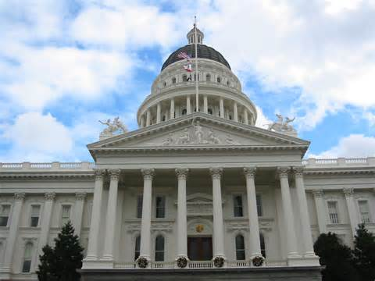
Legislating CLAS
State agencies have embraced the importance of cultural and linguistic competency in the decade since the initial publication of the National CLAS Standards. A number of states have proposed or passed legislation pertaining to cultural competency training for one or more segments of their state’s health professionals.
At least six states have moved to mandate some form of cultural and linguistic competency for either all or a component of its health care workforce.

Slide 13
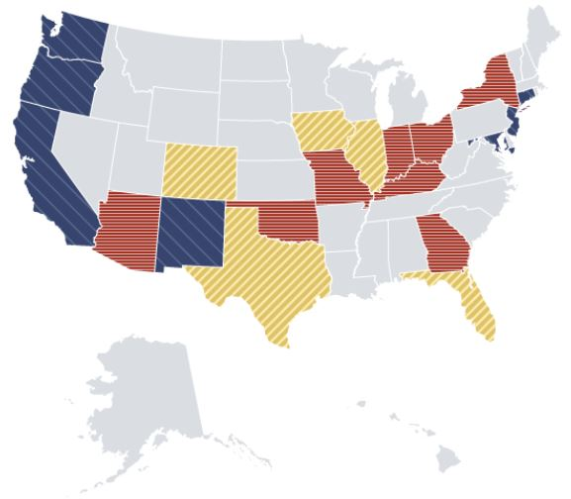
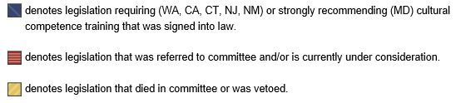
Legislation Map

Slide 14
structure
The enhanced National CLAS Standards are structured as follows:
Principal Standard (Standard 1): Provide effective, equitable, understandable, and respectful quality care and services that are responsive to diverse cultural health beliefs and practices, preferred languages, health literacy, and other communication needs.
Governance, Leadership, and Workforce (Standards 2-4)
Communication and Language Assistance (Standards 5-8)
Engagement, Continuous Improvement, and Accountability (Standards 9-15)

Slide 15
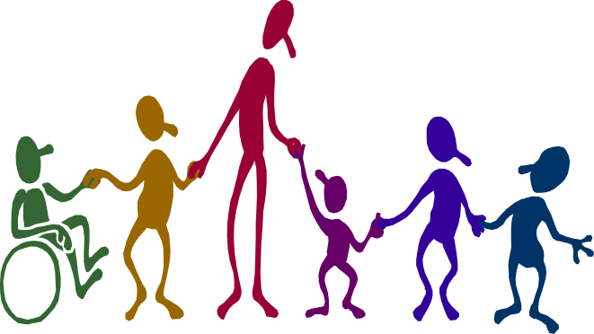
CLAS principal standard
Provide effective, equitable, understandable, and respectful quality care and services that are responsive to diverse cultural health beliefs and practices, preferred languages, health literacy, and other communication needs.

Slide 16

Governance, Leadership and Workforce: Standard 2
Advance and sustain organizational governance and leadership that promotes CLAS and health equity through policy, practices, and allocated resources.

Slide 17

Governance, Leadership and Workforce: Standard 3
Recruit, promote, and support a culturally and linguistically diverse governance, leadership, and workforce that are responsive to the population in the service area.

Slide 18

Governance, Leadership and Workforce: Standard 4
Educate and train governance, leadership, and workforce in culturally and linguistically appropriate policies and practices on an ongoing basis.

Slide 19

Communication and Language Assistance: Standard 5
Offer language assistance to individuals who have limited English proficiency and/or other communication needs, at no cost to them, to facilitate timely access to all health care and services.

Slide 20

Communication and Language Assistance: Standard 6
Inform all individuals of the availability of language assistance services clearly and in their preferred language, verbally and in writing.

Slide 21

Communication and Language Assistance: Standard 7
Ensure the competence of individuals providing language assistance, recognizing that the use of untrained individuals and/or minors as interpreters should be avoided.
Credentials

Slide 22

Communication and Language Assistance: Standard 8
Provide easy-to-understand print and multimedia materials and signage in the languages commonly used by the populations in the service area.

Slide 23

Engagement, Continuous Improvement, and Accountability: Standard 9
Establish culturally and linguistically appropriate goals, policies, and management accountability, and infuse them throughout the organization's planning and operations.

Slide 24

Engagement, Continuous Improvement, and Accountability: Standard 10
Conduct ongoing assessments of the organization's CLAS-related activities and integrate CLAS-related measures into measurement and continuous quality improvement activities.

Slide 25
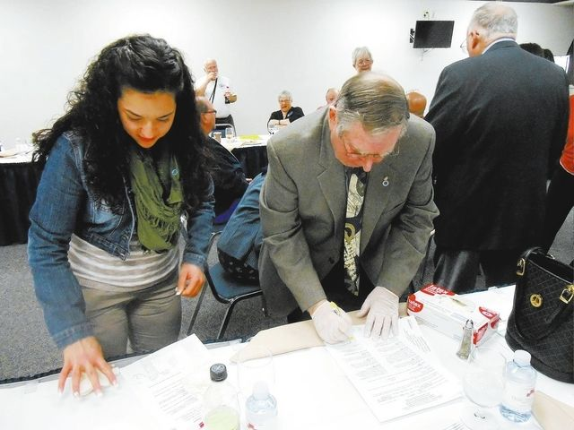
Engagement, Continuous Improvement, and Accountability: Standard 11
Collect and maintain accurate and reliable demographic data to monitor and evaluate the impact of CLAS on health equity and outcomes and to inform service delivery.

Slide 26
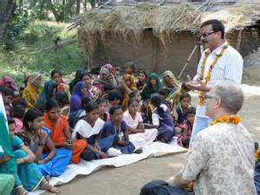
Engagement, Continuous Improvement, and Accountability: Standard 12
Conduct regular assessments of community health assets and needs and use the results to plan and implement services that respond to the cultural and linguistic diversity of populations in the service area.

Slide 27

Engagement, Continuous Improvement, and Accountability: Standard 13
Partner with the community to design, implement, and evaluate policies, practices, and services to ensure cultural and linguistic appropriateness.

Slide 28
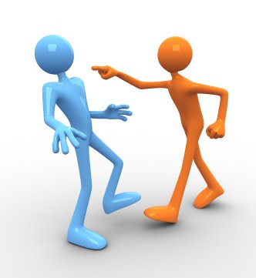
Engagement, Continuous Improvement, and Accountability: Standard 14
Create conflict and grievance resolution processes that are culturally and linguistically appropriate to identify, prevent, and resolve conflicts or complaints.

Slide 29

Engagement, Continuous Improvement, and Accountability: Standard 15
Communicate the organization's progress in implementing and sustaining CLAS to all stakeholders, constituents, and the general public.

Slide 30

intent
The National CLAS Standards are intended to advance health equity, improve quality, and help eliminate health care disparities by establishing a blueprint for health and health care organizations

Slide 31
CLAS standards compliance
To be in compliance with CLAS standards Prospect Medical developed a Culture and Linguistics Plan outlining culturally and linguistically cautious procedures and workflows for successful business operations.
Prospect Medical aims at mirroring it’s membership diversity by hiring representatives of different ethnic and racial backgrounds.
Prospect Medical provides ongoing training opportunities, annual trainings and support to all staff regardless race, color, age or gender. This includes Culture and Linguistic Training, aimed to improve intercultural communication.
Current complaints and grievance procedures allow open communication with all members. Satisfaction surveys furthermore show our willingness to maintain a productive discussion with our communities.

Slide 32
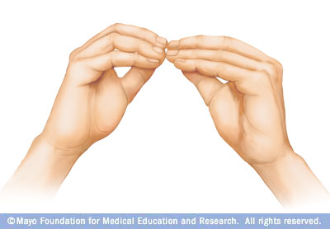
Linguistic Competence

Slide 33

Definition
Competence – the quality of being adequately or well qualified physically and intellectually
Linguistics – the scientific study of language
Linguistic competence – a speaker’s implicit, internalized knowledge of the rules of their language.

Slide 34
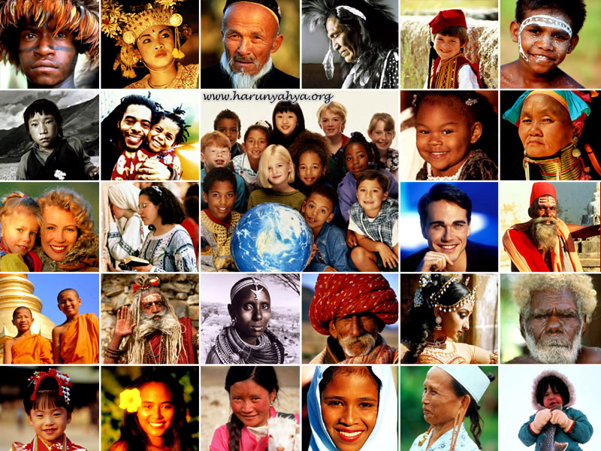
Diverse member population
Prospect Medical’s membership population is very diverse. Members who do not speak English as their primary language and who have a limited ability to read, speak, write, or understand English can be limited English proficient, or "LEP." These individuals may be entitled language assistance with respect to a particular type or service, benefit, or encounter.
We provide: face to face oral and sign language interpretation for medical appointments, telephonic interpretation, translated written communication, braille materials and more.

Slide 35
The largest Health Plans in the nation decided to determine threshold languages – primary languages of their LEP population. Take a look at the next slide.

Slide 36
Threshold Languages
Health Plan | Chinese- traditional characters | Korean | Spanish | Tagalog | Vietnamese
Aetna |  |  | X
Anthem/Blue Cross | X | X | X | X | X
Blue Shield | X |  | X |  | X
Central Coast Alliance for Health |  |  | X
Care1st | X |  | X
Cigna | X |  | X
Cal Optima |  |  | X |  | X
Chinese Community Health Plan | X
Contra Costa Health Plan |  |  | X
Health Net of California | X |  | X
Kaiser Permanente | X |  | X
San Francisco Health Plan | X |  | X
Santa Clara Family Health Plan |  |  | X |  | X
United Healthcare of California | X |  | X
Western Health Advantage |  |  | X
Notes:
The following languages were selected by the plans as the plan’s threshold languages for their lines of business regulated by the Department of Managed Health Care. The language selection was based on the threshold criteria established in the statue as well as operational considerations of each health plan.

Slide 37
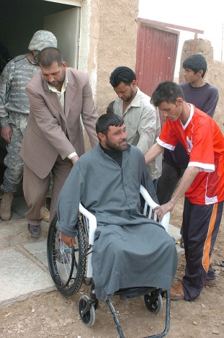
Research indicates that LEP patients face linguistic barriers when accessing health care services. These barriers have a negative impact on patient satisfaction and knowledge of diagnosis and treatment. Patients with linguistic barriers are less likely to seek treatment and preventive services. This leads to poor health outcomes and longer hospital stays.

Slide 38
How to identify LEP Member
Member is quiet or does not respond to questions
Member simply says yes or no, or gives inappropriate or inconsistent answers to your questions
Member may have trouble communicating in English or you may have a very difficult time understanding what they are trying to communicate
Member self identifies as LEP by requesting language assistance.

Slide 39
Working with LEP members
Depending on the nature of communication LEP Members might require an interpreter or translation services

Slide 40
Interpretation vs translation
Interpretation | Translation
Language interpretation, or interpreting, is the facilitating of oral or sign-language communication, either simultaneously or consecutively, between users of different languages. | Translation is the communication of the meaning of a source-language text by means of an equivalent target-language text

Slide 41
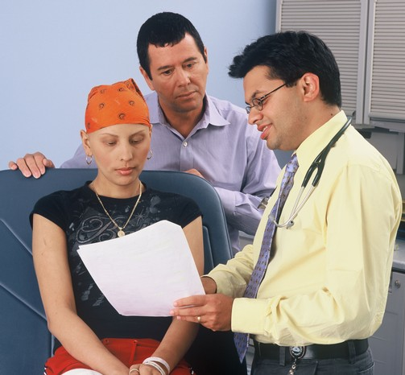
Interpreter
An interpreter is a person who converts a thought or expression in a source language into an expression with a comparable meaning in a target language either simultaneously in "real time" or consecutively after one party has finished speaking. The interpreter's function is to convey every semantic element (tone and register) and every intention and feeling of the message that the source-language speaker is directing to target-language recipients.

Slide 42
Preferred language
LEP Members can be distinguished by checking IDX. Please refer to the IDX Language Preference Indicators Job Aid.
In the event IDX does not reflect member’s preference, politely inquire if member needs a translator in a language other than English.
Advise that interpretation services are available at no charge.

Slide 43
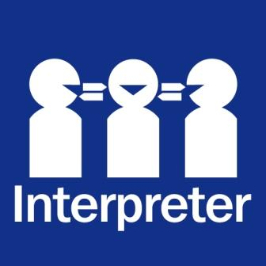
Type of interpreter
Telephone interpreter services are easily accessed and available for short conversations or unusual language requests.
Face-to-face interpreters provide the best communication for sensitive, legal or long communications.
Trained bilingual staff provide consistent patient interactions for a large number of patients.
For reliable patient communication, avoid using minors and family members.

Slide 44

Tips to overcome language barriers
  Use simple words; avoid jargon and acronyms.
  Limit/avoid technical language.
  Speak slowly (don’t shout).
  Articulate words completely.
  Repeat important information.
  Provide educational material in the languages your member reads.
  Use pictures, demonstrations or videos to increase understanding.
  Give information in small chunks and verify comprehension before going on.
  Always confirm patient’s understanding of the information - member’s logic may be different from yours.

Slide 45

Tips for working with telephonic interpreters
  Tell the interpreter the purpose of your call. Describe the type of information you are planning to convey.
  Enunciate your words and try to avoid contractions, which can be easily misunderstood as the opposite of your meaning, e.g., “can’t - cannot.”
  Speak in short sentences, expressing one idea at a time.
  Speak slower than your normal speed of talking, pausing after each phrase.
  Avoid the use of double negatives, e.g., “If you don’t appear in person, you won’t get your benefits.” Instead, “You must come in person in order to get your benefits.”
  Speak in the first person. Avoid the “he said/she said.”
  Avoid using colloquialisms and acronyms, e.g., “LEP.” If you must do so, please explain their meaning.

Slide 46

Tips for working with telephonic interpreters
  Provide brief explanations of technical terms, or medical terms.
  Pause occasionally to ask the interpreter if he or she understands the information that you are providing, or if you need to slow down or speed up in your speech patterns. If the interpreter is confused, so is the client.
  Ask the interpreter if, in his or her opinion, the client seems to have grasped the information that you are conveying. You may have to repeat or clarify certain information by saying it in a different way.
  ABOVE ALL, BE PATIENT with the interpreter, the client and yourself! Thank the interpreter for performing a difficult and valuable service.
  The interpreter will wait for you to initiate the closing of the call and will be the last to disconnect from the call.

Slide 47
Tips for working with telephonic interpreters
When working with an interpreter over a speakerphone or with dual head/handsets, many of the principles of on-site interpreting apply. The only additional thing to remember is that the interpreter is “blind” to the visual cues in the room. The following will help the interpreter do a better job.
When the interpreter comes onto the line let the interpreter know the following:
    Who you are
    Who else is in the room
    What sort of setting this is
    What sort of meeting/discussion this is

Slide 48
Interactive exercise
What does it feel to be LEP Member?
Let’s go through a Linguistic Competence Exercise.
There are a few cards with illnesses, symptoms and descriptions in English. Imagine, you are in a foreign country and you do not speak the Country’s primary language. Explain your illness, symptoms and needs to the doctor (C&L trainer) in their primary language. You can use any available to you resources.

Slide 49

Assistance
Telephonic Interpretation: Language Line 1-800-874-9426
Face to Face Interpretation requires prior authorization
On Site Hearing Impaired 714-401-1051
TDD Access: 1-800-855-2881
For Braille materials contact member’s case worker
For translated materials contact Marketing Department

Slide 50

Cultural competence

Slide 51

culture
The integrated pattern of thoughts, communications, actions, customs, beliefs, values, and institutions associated, wholly or partially, with racial, ethnic, or linguistic groups, as well as with religious, spiritual, biological, geographical, or sociological characteristics.
Culture is dynamic in nature, and individuals identify with multiple cultures in their lifetime.

Slide 52
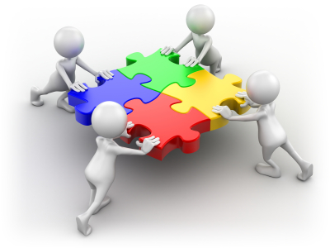
Elements of culture
Age
Cognitive ability or limitations
Country of origin
Degree of acculturation
Education level attained
Environment and surroundings
Family and household composition
Gender identity
Generation
Notes:
Gender is your sex when you are born, gender identity is something you consciously choose as you become an adult.

Slide 53
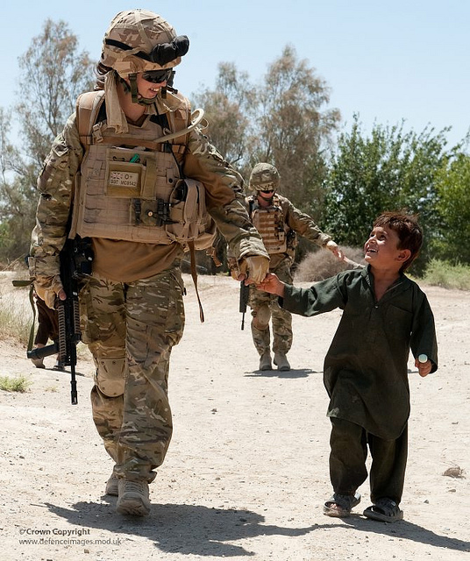
Elements of culture
Military affiliation
Occupational groups
Perceptions of family and community
Perceptions of health and well-being and related practices
Perceptions/beliefs regarding diet and nutrition
Health practices, including use of traditional healer techniques such as Reiki and acupuncture
Linguistic characteristics, including language(s) spoken, written, or signed; dialects or regional variants; literacy levels and other related communication needs

Slide 54

Elements of culture
Residence (i.e., urban, rural, or suburban)
Sex
Sexual orientation
Socioeconomic status
Physical ability or limitations
Political beliefs
Racial and ethnic groups
Religious and spiritual characteristics, including beliefs, practices, and support systems related to how an individual finds and defines meaning in his/her life

Slide 55
Cultural diversity
This term is used to describe differences in ethnic or racial classification and self-identification, tribal or clan affiliation, nationality, language, age, gender, sexual orientation, gender identity or expression, socioeconomic status, education, religion, spirituality, physical and intellectual abilities, personal appearance, and other factors that distinguish one group or individual from another.

Slide 56

Cultural competence
Cultural competence is a learning process that aims to achieve culturally congruent care and higher levels of cultural sensitivity.
Professional standards, societal needs, ethical considerations and legal issues all declare the need to prioritize cultural competence in the employee training.
Cultural competence refers to an ability to interact effectively with people of different cultures and socio-economic backgrounds, particularly in the context of entities whose employees work with persons from different cultural/ethnic backgrounds.

Slide 57

Cultural competence comprises four components:
Awareness of one's own cultural worldview
Knowledge of different cultural practices and worldviews
Attitude towards cultural differences
Cross-cultural skills
Developing cultural competence results in an ability to understand, communicate with, and effectively interact with people across cultures.

Slide 58

Self-assessment
Please watch a video that was created for JCPS staff. It outlines key questions and will allow you become more aware of your cultural competency.
Please click here.

Slide 59

Cultural incompetence encourages:
Disparity
Privilege
Prejudice
Stereotype
Bias
Discrimination
Isms (Ageism, Sexism, Racism)

Slide 60
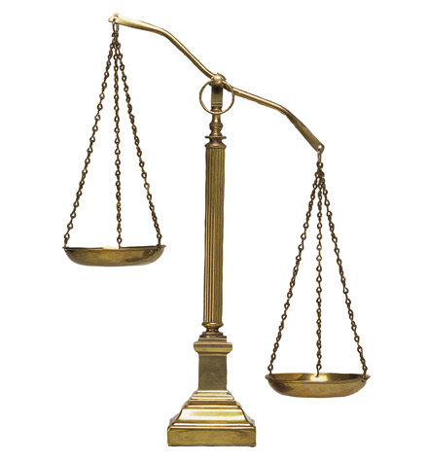
disparity
From Middle French disparité.
the state of being unequal; difference

Slide 61
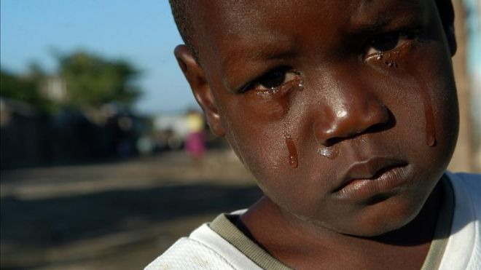
Health Disparity
The United States historically had large disparities in health and access to adequate healthcare between races. Current evidence supports the notion that these racially centered disparities continue to exist and are a significant social health issue. The disparities in access to adequate healthcare include differences in the quality of care based on race and overall insurance coverage based on race. The Journal of the American Medical Association identifies race as a significant determinant in the level of quality of care, with ethnic minority groups receiving less intensive and lower quality care. Ethnic minorities also receive less preventative care, are seen less by specialists, and have fewer expensive and technical procedures than non-ethnic minorities. In fact, Hispanic children are almost three times less likely to receive routine health care as white children, and only 16% of white patients lack routine health care, as compared to about 20% of African Americans and 30% of Hispanic patients.

Slide 62

privilege
A special right, advantage, or immunity granted or available only to a particular person or group of people.
Privilege refers to the idea that in human society, some groups benefit from unearned, largely-unacknowledged advantages that increase their power relative to that of others, thereby perpetuating social inequality. Privilege is generally invisible to those who have it, and a person's level of privilege is influenced by multiple factors including race, gender, age, sexual orientation, and social class, and changes over time.
Privilege has many benefits, including ones that are financial or material such as access to housing, education, and jobs, as well as others that are emotional or psychological, such as a sense of personal self-confidence and comfort, or having a sense of belonging or worth in society.

Slide 63

prejudice
Preconceived opinion that is not based on reason or actual experience.
Prejudice is prejudgment, or forming an opinion before becoming aware of the relevant facts of a case. The word is often used to refer to preconceived, usually unfavorable, judgments toward people or a person because of gender, political opinion, social class, age, disability, religion, sexuality, race/ethnicity, language, nationality or other personal characteristics. In this case, it refers to a positive or negative evaluation of another person based on their perceived group membership. Prejudice can also refer to unfounded beliefs and may include "any unreasonable attitude that is unusually resistant to rational influence”. Gordon Allport defines prejudice as a "feeling, favorable or unfavorable, toward a person or thing, prior to, or not based on, actual experience".

Slide 64

stereotype
A widely held but fixed and oversimplified image or idea of a particular type of person or thing.
In social psychology, a stereotype is a thought that can be adopted about specific types of individuals or certain ways of doing things. These thoughts or beliefs may or may not accurately reflect reality. However, this is only a fundamental psychological definition of a stereotype. Within psychology and spanning across other disciplines, there are different conceptualizations and theories of stereotyping that provide their own expanded definition. Some of these definitions share commonalities, though each one may also harbor unique aspects that may contradict the others.
The term stereotype derives from the Greek words στερεός (stereos), "firm, solid" and τύπος (typos), "impression," hence "solid impression".
The term comes from the printing trade and was first adopted in 1798 by Firmin Didot to describe a printing plate that duplicated any typography. The duplicate printing plate, or the stereotype, is used for printing instead of the original.
Outside of printing, the first reference to "stereotype" was in 1850, as a noun that meant "image perpetuated without change." However, it was not until 1922 that "stereotype" was first used in the modern psychological sense by American journalist Walter Lippmann in his work Public Opinion.

Slide 65
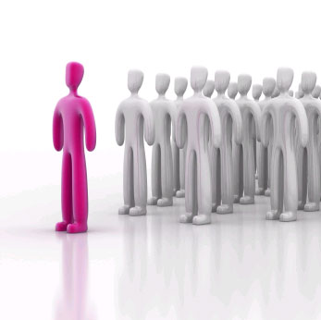
bias
Bias is an inclination of temperament or outlook to present or hold a partial perspective, often accompanied by a refusal to even consider the possible merits of alternative points of view. People may be biased toward or against an individual, a race, a religion, a social class, or a political party. Biased means one-sided, lacking a neutral viewpoint, not having an open mind. Bias can come in many forms and is often considered to be synonymous with prejudice or bigotry.

Slide 66

discrimination
Discrimination is action that denies social participation or human rights to categories of people based on prejudice. This includes treatment of an individual or group based on their actual or perceived membership in a certain group or social category, "in a way that is worse than the way people are usually treated".
It involves the group's initial reaction or interaction, influencing the individual's actual behavior towards the group or the group leader, restricting members of one group from opportunities or privileges that are available to another group, leading to the exclusion of the individual or entities based on logical or irrational decision making.

Slide 67
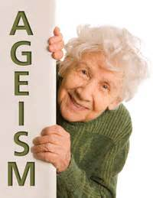
ageism
Ageism (also spelled "agism") is stereotyping and discriminating against individuals or groups on the basis of their age. This may be casual or systematic. The term was coined in 1969 by Robert Neil Butler to describe discrimination against seniors, and patterned on sexism and racism. Butler defined "ageism" as a combination of three connected elements. Among them were prejudicial attitudes towards older people, old age, and the aging process; discriminatory practices against older people; and institutional practices and policies that perpetuate stereotypes about older people.
The term has also been used to describe prejudice and discrimination against adolescents and children, including ignoring their ideas because they are too young, or assuming that they should behave in certain ways because of their age.

Slide 68
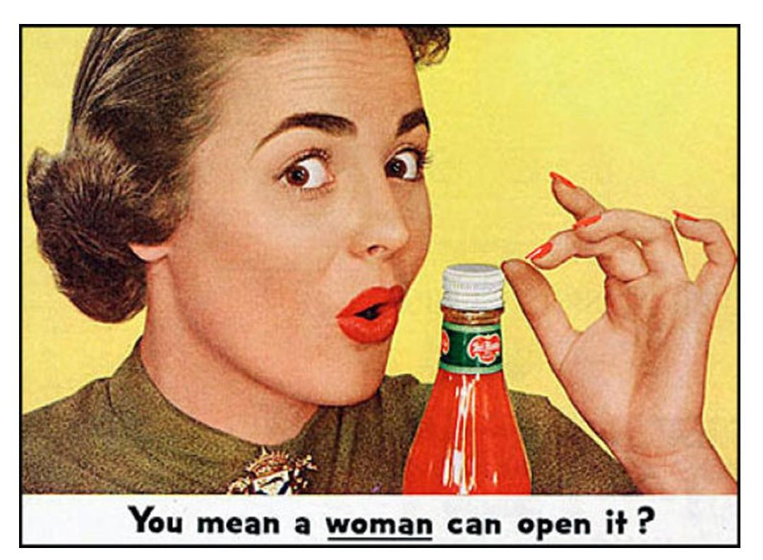
sexism
Sexism or gender discrimination is prejudice or discrimination based on a person's sex or gender. Sexist attitudes may stem from traditional stereotypes of gender roles and may include the belief that a person of one sex is intrinsically superior to a person of the other. A job applicant may face discriminatory hiring practices, or (if hired) receive unequal compensation or treatment compared to that of their opposite-sex peers. Extreme sexism may foster sexual harassment, rape and other forms of sexual violence.

Slide 69
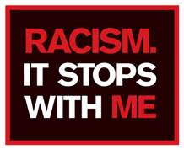
Racism
Racism consists of both prejudice and discrimination based in social perceptions of biological differences between peoples. It often takes the form of social actions, practices or beliefs, or political systems that consider different races to be ranked as inherently superior or inferior to each other, based on presumed shared inheritable traits, abilities, or qualities. It may also hold that members of different races should be treated differently.
Among the questions about how to define racism is the question of whether to include forms of discrimination that are unintentional, such as making assumptions about preferences or abilities of others based on racial stereotypes, whether to include symbolic or institutionalized forms of discrimination such as the circulation of ethnic stereotypes through the media, and whether to include the socio-political dynamics of social stratification that sometimes have a racial component.

Slide 70

Tips for successful intercultural interaction

Slide 71
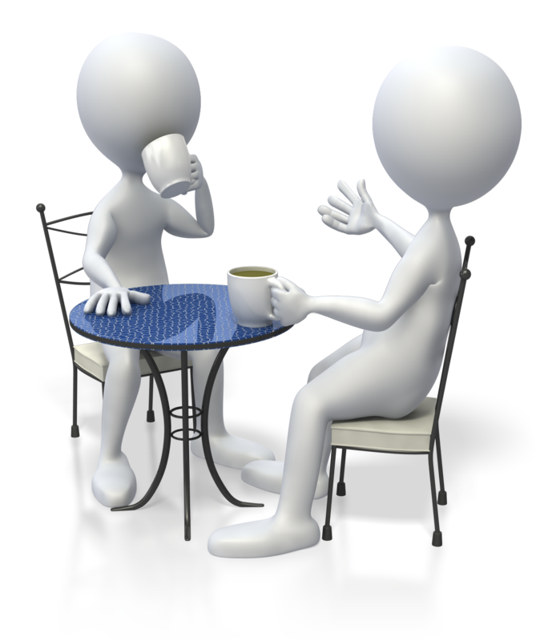
Styles of speech
People vary greatly in length of time between comment and response, the speed of their speech, and their willingness to interrupt.
Tolerate gaps between questions and answers, impatience can be seen as a sign of disrespect.
Listen to the volume and speed of the patient’s speech as well as the content. Modify your own speech to more closely match that of the patient to make them more comfortable.
Rapid exchanges, and even interruptions, are a part of some conversational styles. Don’t be offended if no offense is intended when a patient interrupts you.
Stay aware of your own pattern of interruptions, especially if the patient is older than you are.

Slide 72

Eye Contact
The way people interpret various types of eye contact is tied to cultural background and life experience.
Most Euro-Americans expect to look people directly in the eyes and interpret failure to do so as a sign of dishonesty or disrespect.
For many other cultures direct gazing is considered rude or disrespectful. Never force a patient to make eye contact with you.
If a patient seems uncomfortable with direct gazes, try sitting next to them instead of across from them.

Slide 73
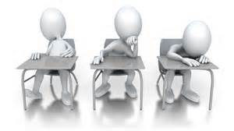

Body language
Sociologists say that 80% of communication is non-verbal. The meaning of body language varies greatly by culture, class, gender, and age.
Follow the patient’s lead on physical distance and touching. If the patient moves closer to you or touches you, you may do the same. However, stay sensitive to those who do not feel comfortable, and ask permission to touch them.
Gestures can mean very different things to different people. Be very conservative in your own use of gestures and body language. Ask patients about unknown gestures or reactions.
Do not interpret a patient’s feelings or level of pain just from facial expressions. The way that pain or fear is expressed is closely tied to a person’s cultural and personal background.

Slide 74

Guiding conversation
English predisposes us to a direct communication style; however, other languages and cultures differ.
Initial greetings can set the tone for the visit. Many older people from traditional societies expect to be addressed more formally, no matter how long they have known their physician. If the patient’s preference is not clear, ask how they would like to be addressed.
Patients from other language or cultural backgrounds may be less likely to ask questions and more likely to answer questions through narrative than with direct responses. Facilitate patient-centered communication by asking open-ended questions whenever possible.
Avoid questions that can be answered with “yes” or “no.” Research indicates that when patients, regardless of cultural background, are asked, “Do you understand,” many will answer, “yes” even when they really do not understand. This tends to be more common in teens and older patients.
Steer the patient back to the topic by asking a question that clearly demonstrates that you are listening. Some patients can tell you more about their health through story telling than by answering direct questions.

Slide 75
Community resources
California State Minority Health Contact
Wm. Jahmal Miller, MHA
Deputy Director
Office of Health Equity
California Department of Public Health
1615 Capitol Avenue
Sacramento, CA 95899-7413
Phone: (916) 558-1821
Fax: (916) 558-1762
Email: Jahmal.Miller@cdph.ca.gov
Website: http://cdph.ca.gov

Slide 76
Community resources
National Institute on Minority Health and Health Disparities (NIMHD)
Yvonne T. Maddox, PhD
Acting Director, National Institute on Minority Health and Health Disparities
National Institutes of Health
6707 Democracy Blvd. Suite 800
Bethesda, MD 20892-5465
301-402-1366
maddoxy@exchange.nih.gov

Slide 77
Community resources
Centers for Medicare & Medicaid Services (CMS)
Cara V. James, PhD
Director, Office of Minority Health
7500 Security Blvd.
Baltimore, MD 21244
410-786-6842
Cara.James@cms.hhs.gov

Slide 78
Community resources
Centers for Disease Control and Prevention (CDC)
Leandris Liburd, PhD, MPH
Director, Office of Minority Health and Health Equity
Mail stop K-77
4770 Buford Hwy
Atlanta, GA 30329
770-488-8200
Leandris.Liburd@cdc.hhs.gov

Slide 79
Community resources
National Institute on Minority Health and Health Disparities
http://www.nimhd.nih.gov/
National Minority Organizations:
http://www.minorityhealth.hhs.gov/npa/templates/browse.aspx?lvl=3&lvlid=31

